Slide 1


Planning for Storytelling
Nisha Simon
Christian Muise
Rogelio E. Cardona-Rivera
Arnav Jhala
Julie Porteous
R. Michael Young
Patrik Haslum

Slide 2



Why Planning for Storytelling?
A story can be conceptualized as the sequence of events that take place within some virtual world.
It can therefore be well-modeled by a plan.

Slide 3

The Plan
The plan can represent:
the sequence of events that actually happen in the story i.e. the plot, or,
the sequence of events are they are told to the audience i.e. the narrative.

Slide 4
States
The states that the plan traverses can encompass:
the physical state of the story world;
the state of mind of the characters in the story world (their beliefs, motivations, plans, etc.);
the state of the audience’s knowledge/understanding of the world and events of the story; or
any combination of the above.

Slide 5
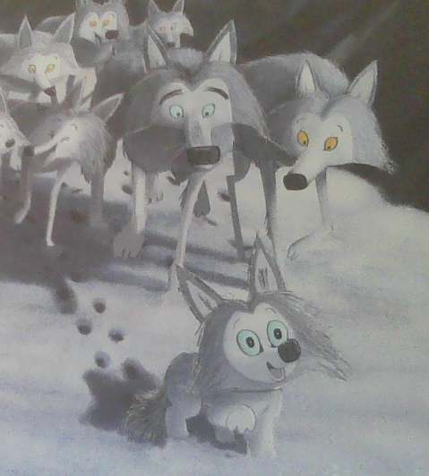
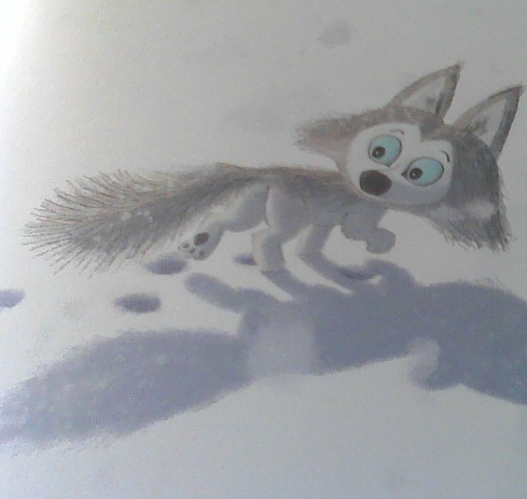
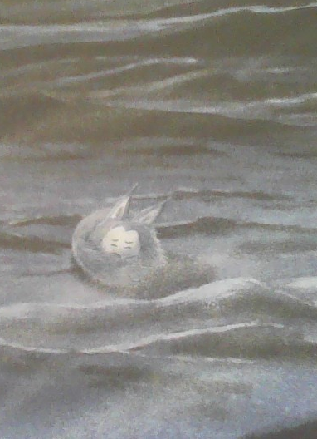
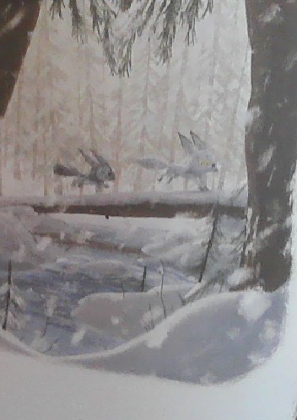
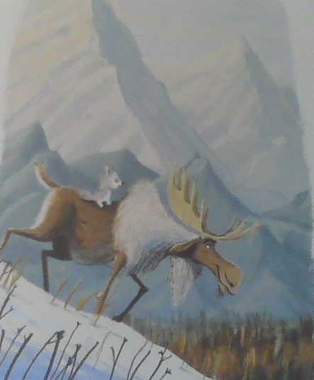
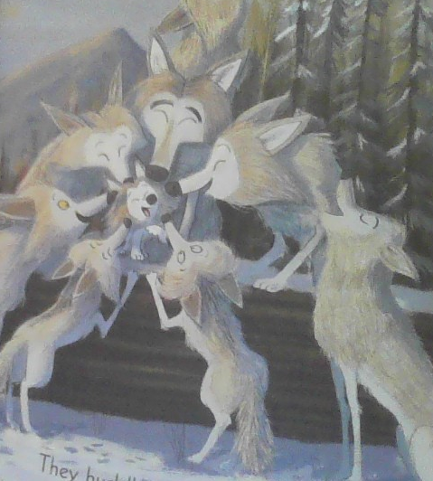
States
The physical state of the story world:
** “The Way Home for Wolf” images courtesy: Bright, R.; and Field, J., 2020, “The Way Home for Wolf”, volume 1, Scholastic Press.

Slide 6
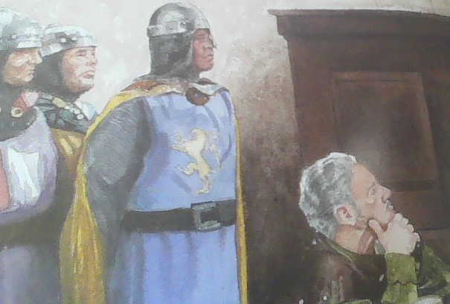
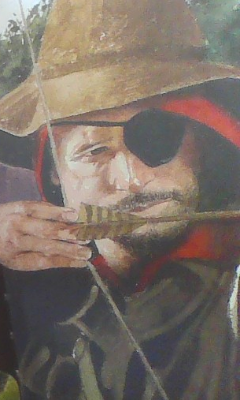
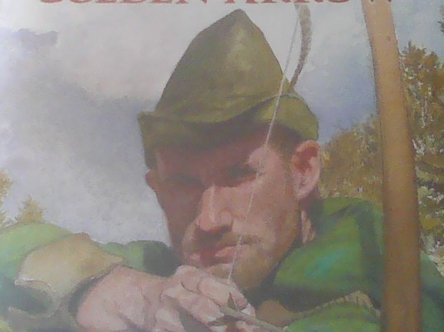
States
The state of mind of the characters in the story world:
* “Robin Hood” images courtesy: San Souci, R. D.; and Lewis, E., 2010, “Robin Hood and the Golden Arrow”, volume 1, Scholastic Press.

Slide 7
Our Plan
The plan becomes:
the representation of the story, and
also, that of the story world
Thus, we use Planning to create logical, believable, and coherent stories (narratives) in a variety of domains.

Slide 8
Our Plan
We will demonstrate the role that planning, or planning-based representations, can play in narrative generation methods.
We will cover several techniques, including modern approaches that make use of Large Language Models (LLMs)

Slide 9


Storytelling + Planning Task
+

Slide 10
Who did What? – the plot thickens…
Storytelling is a `design’ task
– Which phenomenon to model?
Logic
Mistaken belief
Suspense etc.

Slide 11
Who did What? – the plot thickens…
Storytelling is a `design’ task
– Which layer to model?
Plot
Discourse
Narration

Slide 12
Who did What? – the plot thickens…
Neural based approaches
Story Skeletons
Compilation to Classical Planning
Neurosymbolic approaches
Story Variations
Directed graphs and branching story trees
Large Language Models

Slide 13
Who did What? – the plot thickens…
Neural based approaches
Story Skeletons
Compilation to Classical Planning
Neurosymbolic approaches
Story Variations
Directed graphs and branching story trees
Large Language Models

Slide 14

The Storyteller
Large Input Datasets
Generated Text
LLM

Slide 15
If you fail to plan….
What are some challenges in generating text using LLMs?
Display bias
Produce toxic or offensive outputs
Dissolve into repetition
Produce illogical output

Slide 16
What’s my Line?
Prompt engineering for LLMs.
LLMs are constantly improving, but their outputs are still dependent on their inputs.

Slide 17
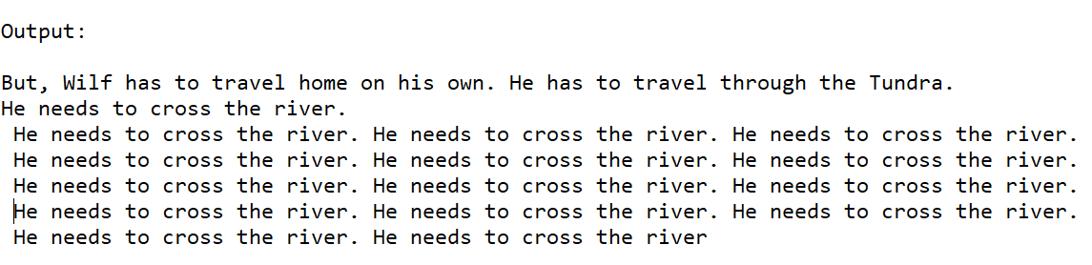
What’s my Line?

Slide 18
The Storyteller
Plan
Here’s where I come in!
Large Input Datasets
Generated Text
LLM

Slide 19
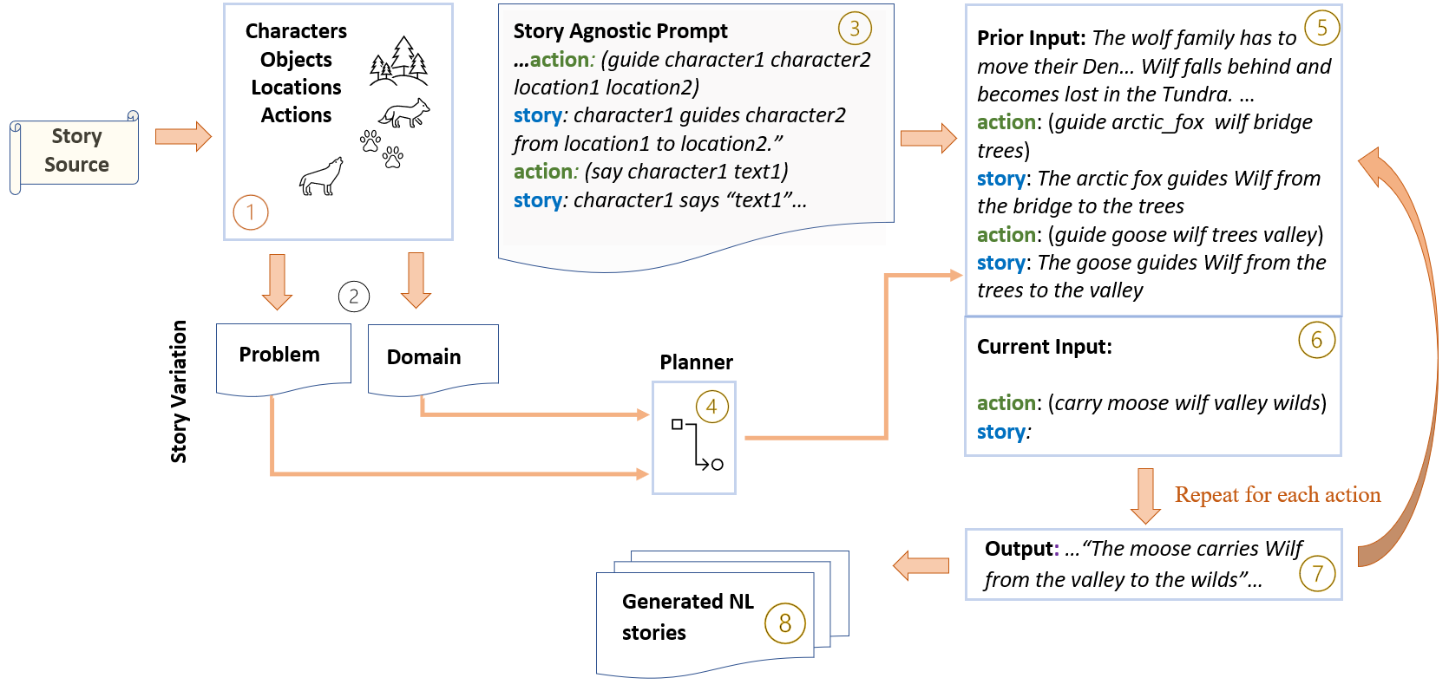
The Storyteller

Slide 20
The Storyteller

Slide 21
The Storyteller

Slide 22
The Storyteller

Slide 23
The Storyteller

Slide 24
The Storyteller

Slide 25
The Storyteller

Slide 26
The Storyteller

Slide 27
The Storyteller

Slide 28
The Storyteller

Slide 29
Tell me a Story
Interactive Session!

Slide 30
Tell me a Story
Initial Story: The Way Home for Wolf
Let’s hear a story about Wilf:
https://www.youtube.com/watch?v=Sqq8Hoz37VQ * (* The authors claim no responsibility for the content of external sites)

Slide 31
Tell me a Story
Initial Story: The Way Home for Wolf
Now let’s extract the story elements:
Characters:
Objects:
Verbs:

Slide 32
Tell me a Story
Initial Story: The Way Home for Wolf
Characters: wilf, goose, moose...
Objects: --
Verbs: guide, carry...

Slide 33
Tell me a Story
Let’s use the story elements to write some pddl using the Online Planning Editor:
In a browser, open the pddl online editor (load your own files): https://editor.planning.domains/
Or
In a browser, open the session: https://editor.planning.domains/#read_session=wO492qnhbg

Slide 34
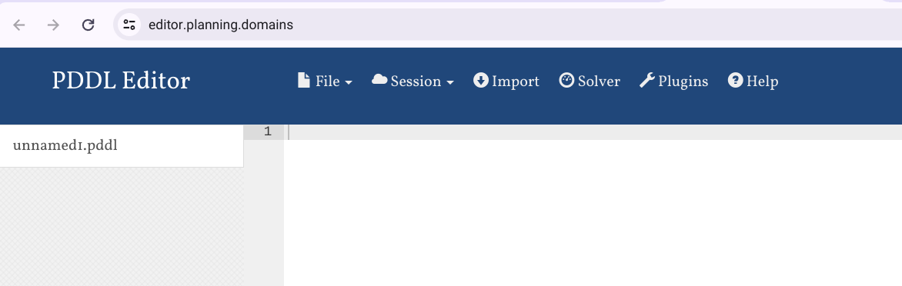
Tell me a Story

Slide 35
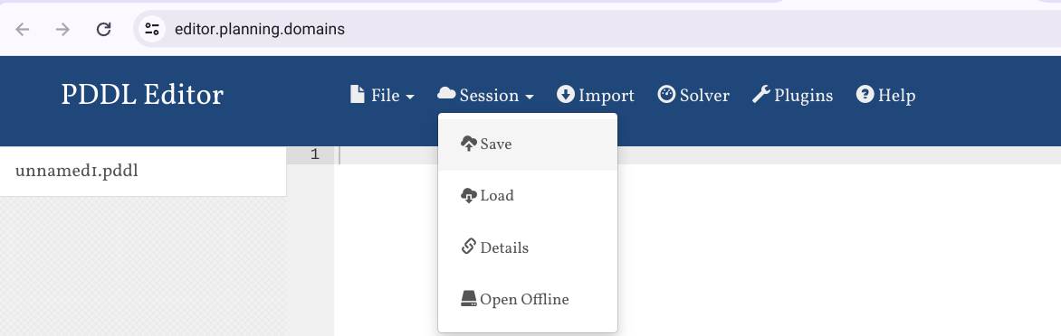
Tell me a Story

Slide 36
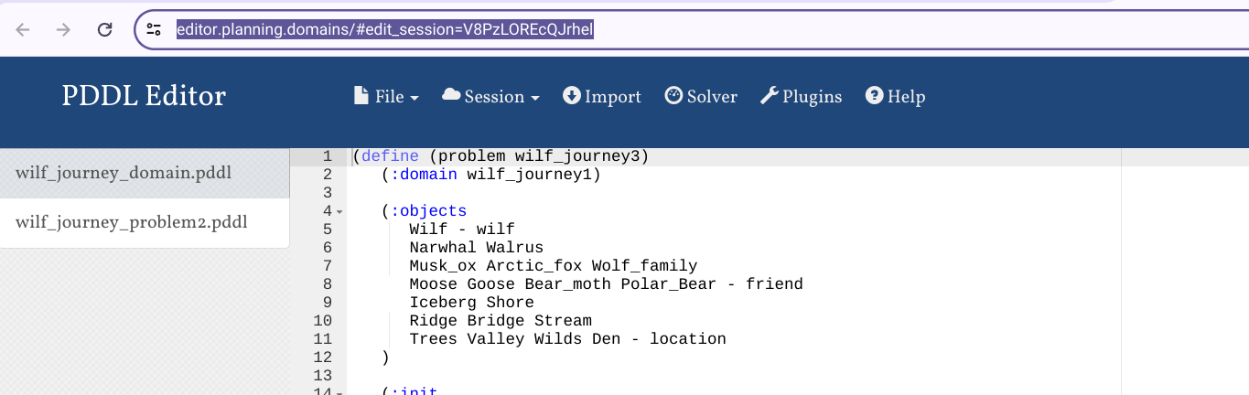
Tell me a Story

Slide 37
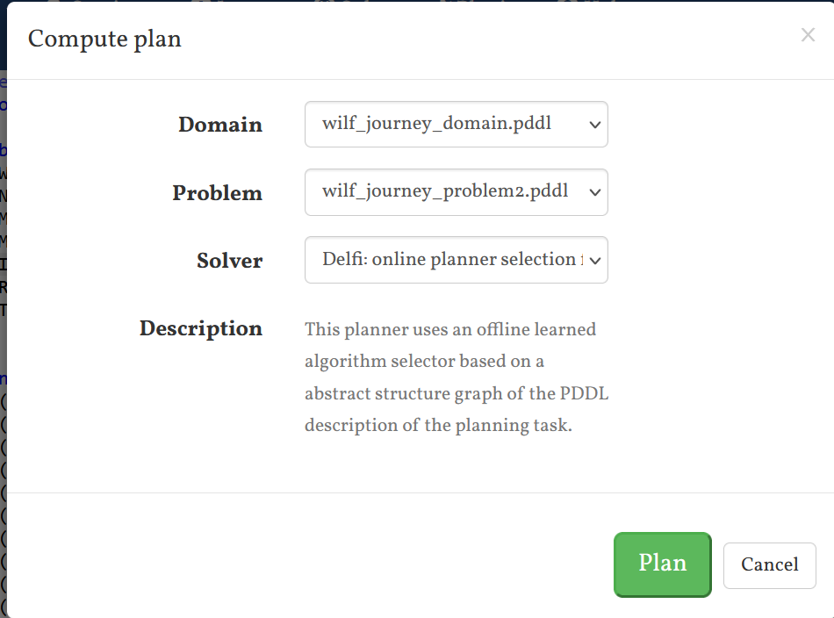
Tell me a Story

Slide 38
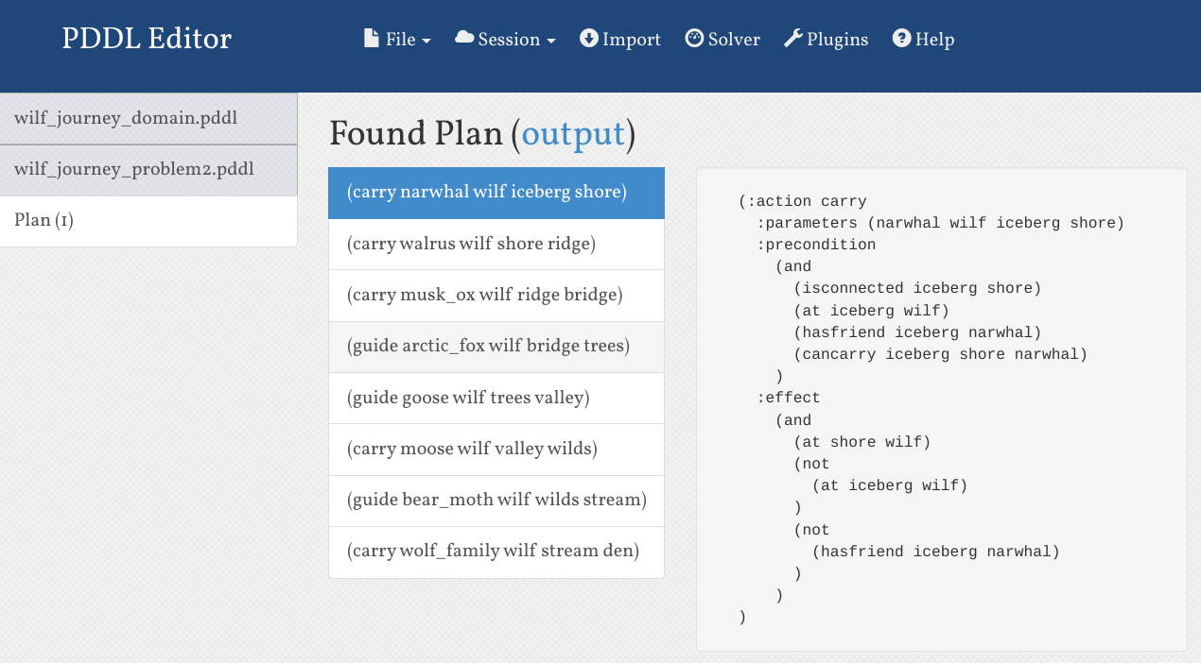
Tell me a Story

Slide 39
Tell me a Story
Initial Story: The Paper-bag Princess
(Robert Munsch, Annick Press, 1980)
Characters: princess, prince, dragon …
Objects: castle, clothes, paper bag…
Verbs: follow, breathe fire, burn, …

Slide 40
Tell me a Story
(attack_castle dragon clothes ronald)
(follow_dragon dragon clothes elizabeth paper_bag)
(charm_dragon dragon elizabeth)
(flatter_dragon dragon elizabeth)
(breathe_large_fire dragon)
(fly_fast dragon)
(fall_asleep dragon)
(rescue_prince ronald dragon)
(insult ronald elizabeth paper_bag)
(call_off_wedding elizabeth paper_bag)
Valid Plan

Slide 41
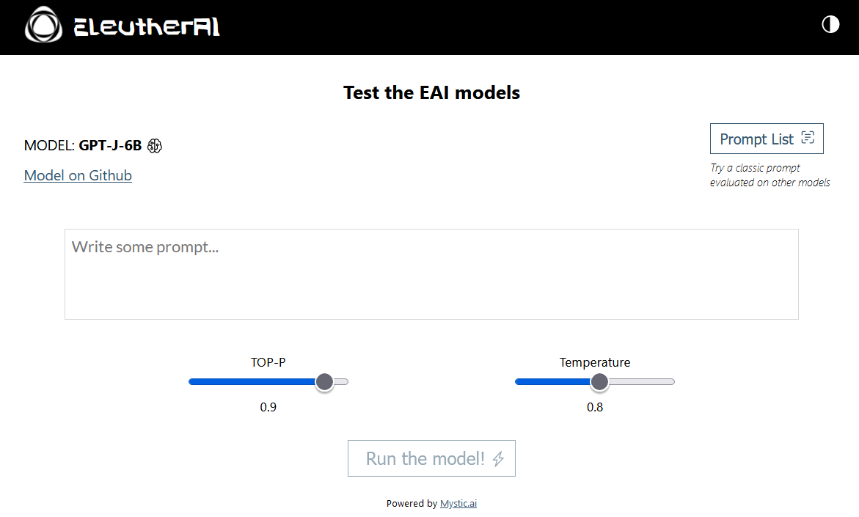
Tell me a Story
Interface to the LLM

Slide 42
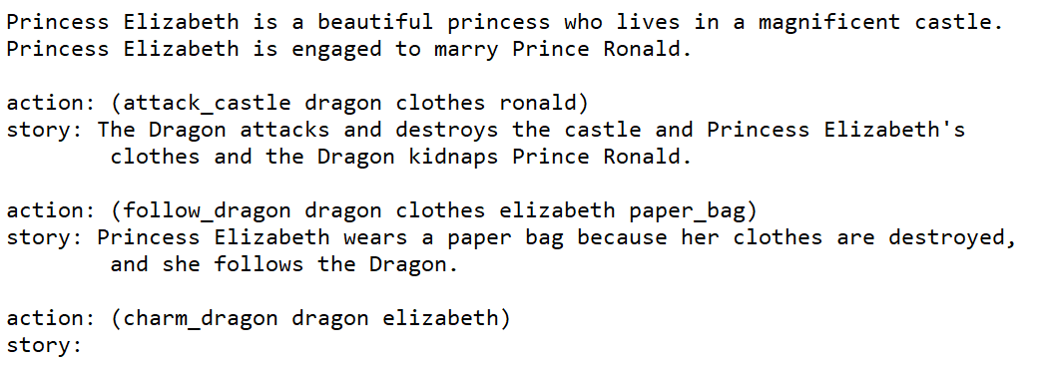
Tell me a Story
Initial Input to the LLM

Slide 43
Tell me a Story
Actions from the generated plan

Slide 44
Tell me a Story
NL text or ‘story’ line
Can the LLM generate the next line of the story?

Slide 45
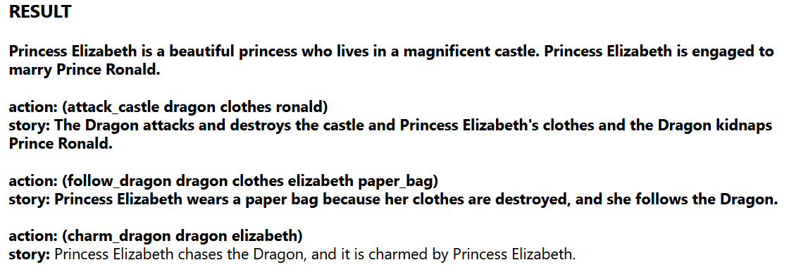

Tell me a Story
Initial Output from LLM

Slide 46
Tell me a Story
Generated NL Story
Princess Elizabeth is a beautiful princess who lives in a magnificent castle. Princess Elizabeth is engaged to marry Prince Ronald.
The Dragon attacks and destroys the castle and Princess Elizabeth's clothes and the Dragon kidnaps Prince Ronald.
Princess Elizabeth wears a paper bag because her clothes are destroyed, and she follows the Dragon.
Princess Elizabeth chases the Dragon, and it is charmed by Princess Elizabeth.
Princess Elizabeth flatters the Dragon, and the Dragon likes Princess Elizabeth.
The Dragon breathes large flames.
The Dragon flies fast.
The Dragon falls asleep.
Princess Elizabeth saves Prince Ronald from the Dragon.
Prince Ronald insults Princess Elizabeth, and she wears a paper bag because she is wearing no clothes.
Princess Elizabeth calls off the wedding, and she is wearing a paper bag.

Slide 47
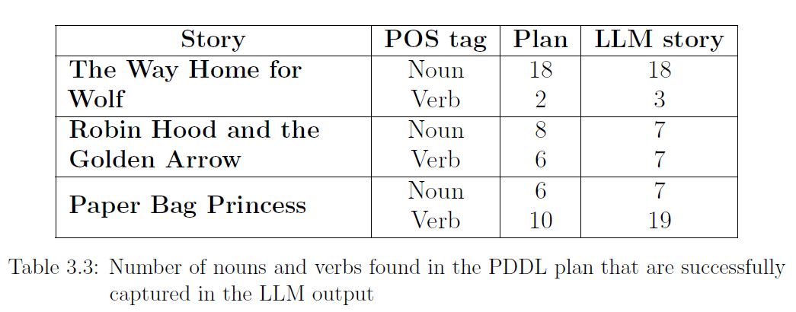
The proof of the pudding….
Evaluation

Slide 48
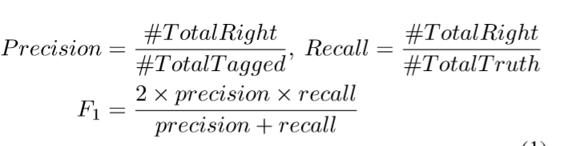
The proof of the pudding….
Evaluation
(Olmo et al. 2021)
“Common automated evaluation metrics for story generation such as perplexity and BLEU … only measure whether a generator can recreate the ground truth corpus.”
(Castricato et al. 2021)

Slide 49
The proof of the pudding….
1. This story exhibits CORRECT GRAMMAR.
2. This story's events occur in a PLAUSIBLE ORDER.
3. This story's sentences MAKE SENSE given sentences before and after them.
4. This story AVOIDS REPETITION.
5. This story uses INTERESTING LANGUAGE.
6. This story is of HIGH QUALITY.
7. This story is ENJOYABLE.
8. This story REMINDS ME OF A SOAP OPERA.
9. This story FOLLOWS A SINGLE PLOT.
Likert scale
1. Strongly Disagree,
5. Strongly Agree
(Martin. 2018)

Slide 50
The proof of the pudding….
Which story’s events occur in a more PLAUSIBLE ORDER?
Which story’s sentences MAKE MORE SENSE given sentences before and after them?
Which story better follows a SINGLE PLOT?
Which story is of HIGHER QUALITY?
Which story is more ENJOYABLE?
Pick between two stories
(Castricato et al. . 2021)

Slide 51
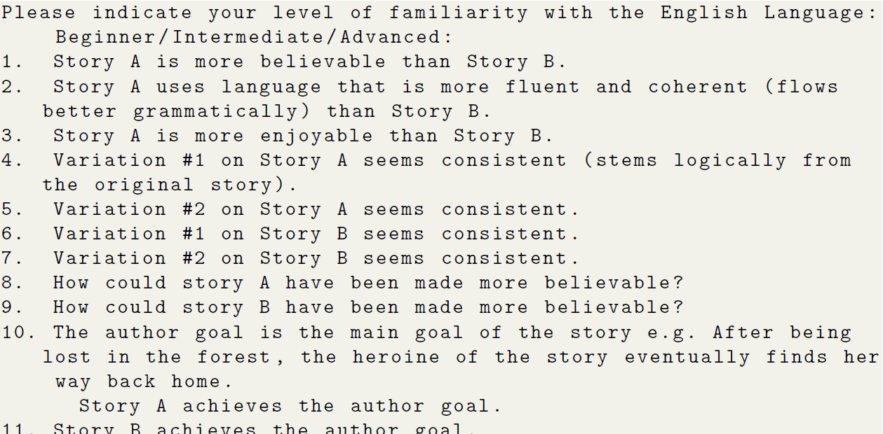
The proof of the pudding….

Slide 52
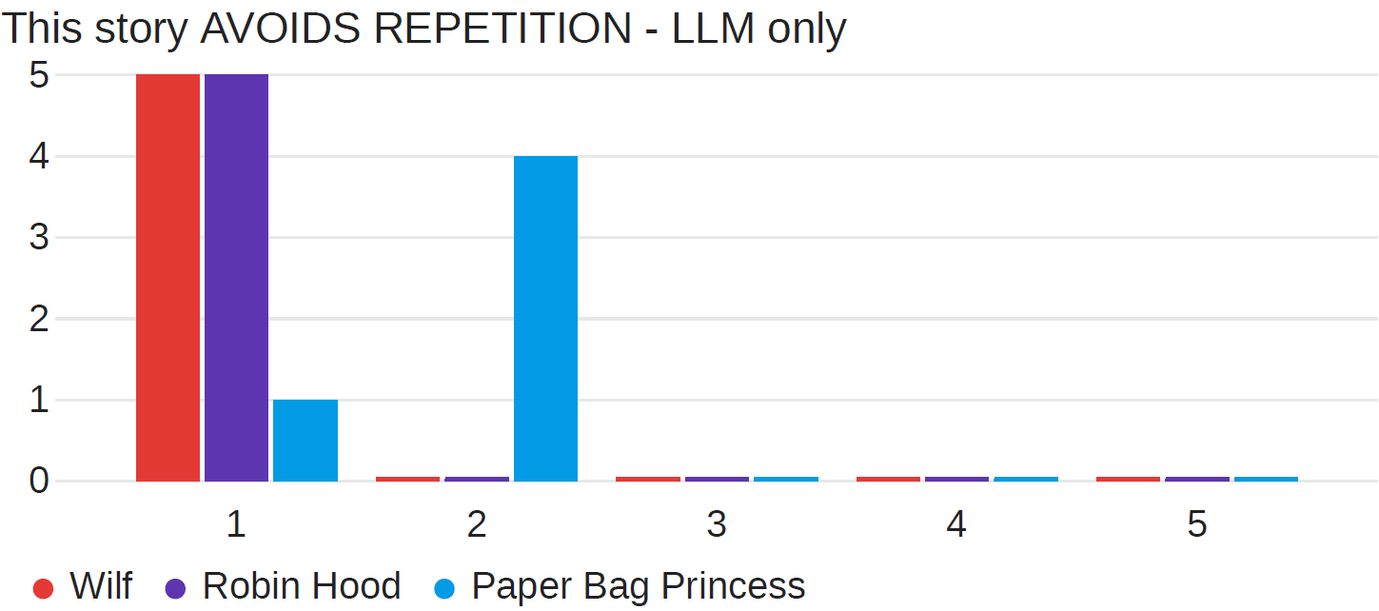
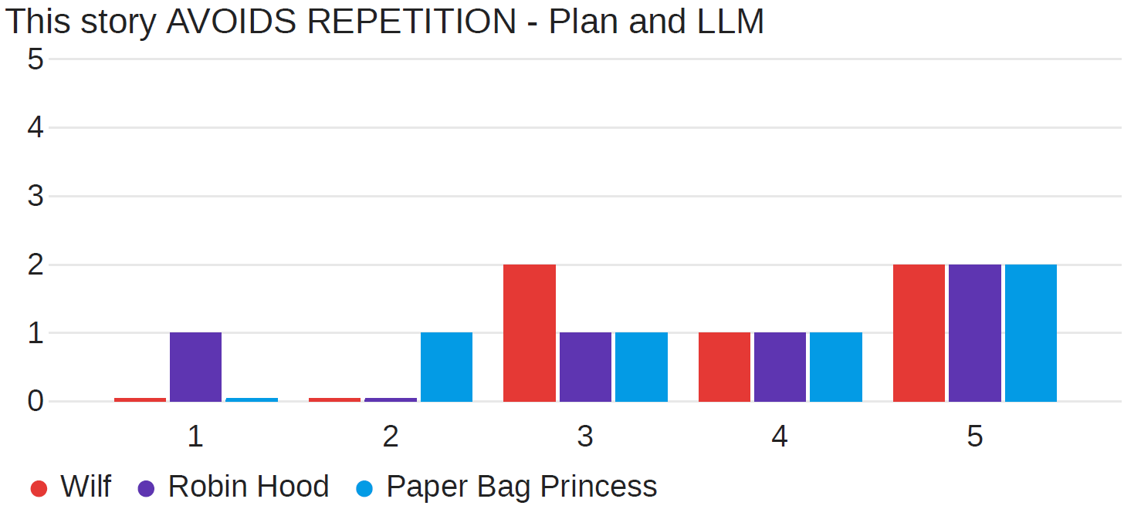
The proof of the pudding….

Slide 53
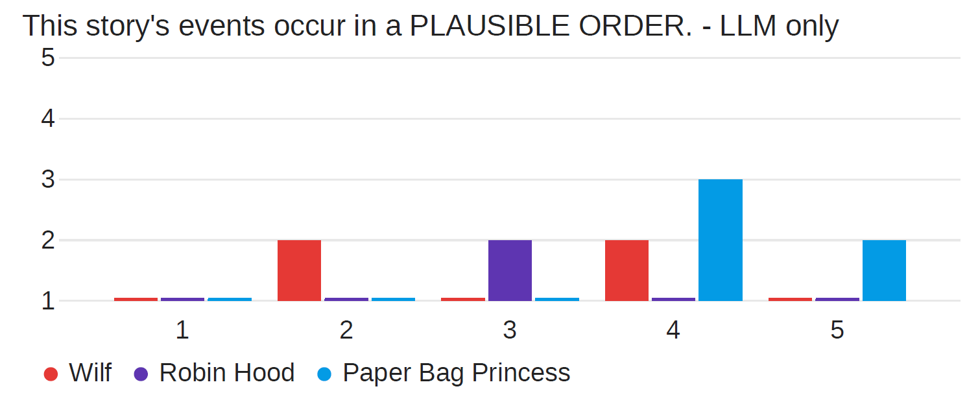
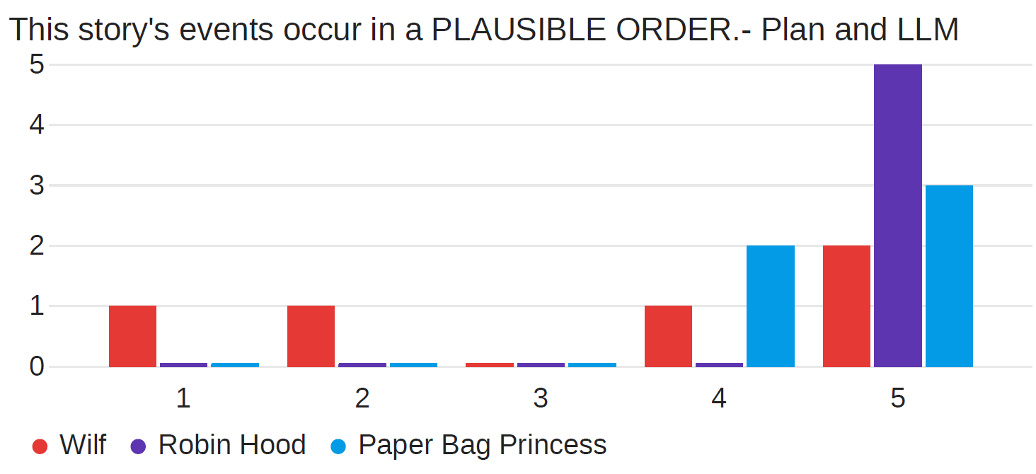
The proof of the pudding….

Slide 54
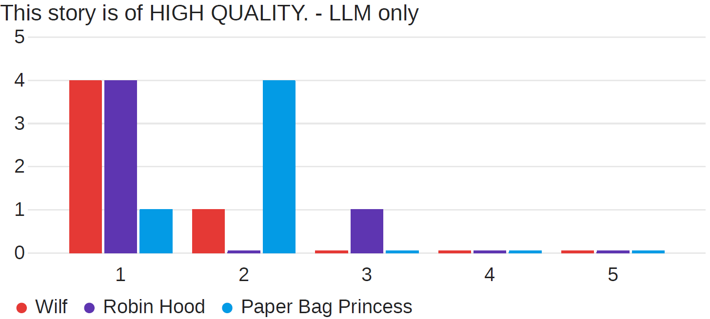
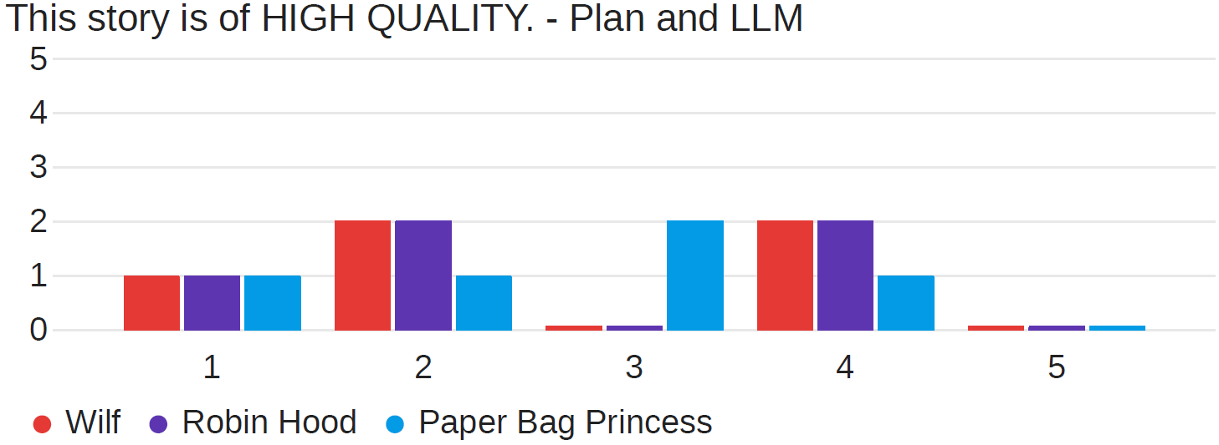
The proof of the pudding….

Slide 55
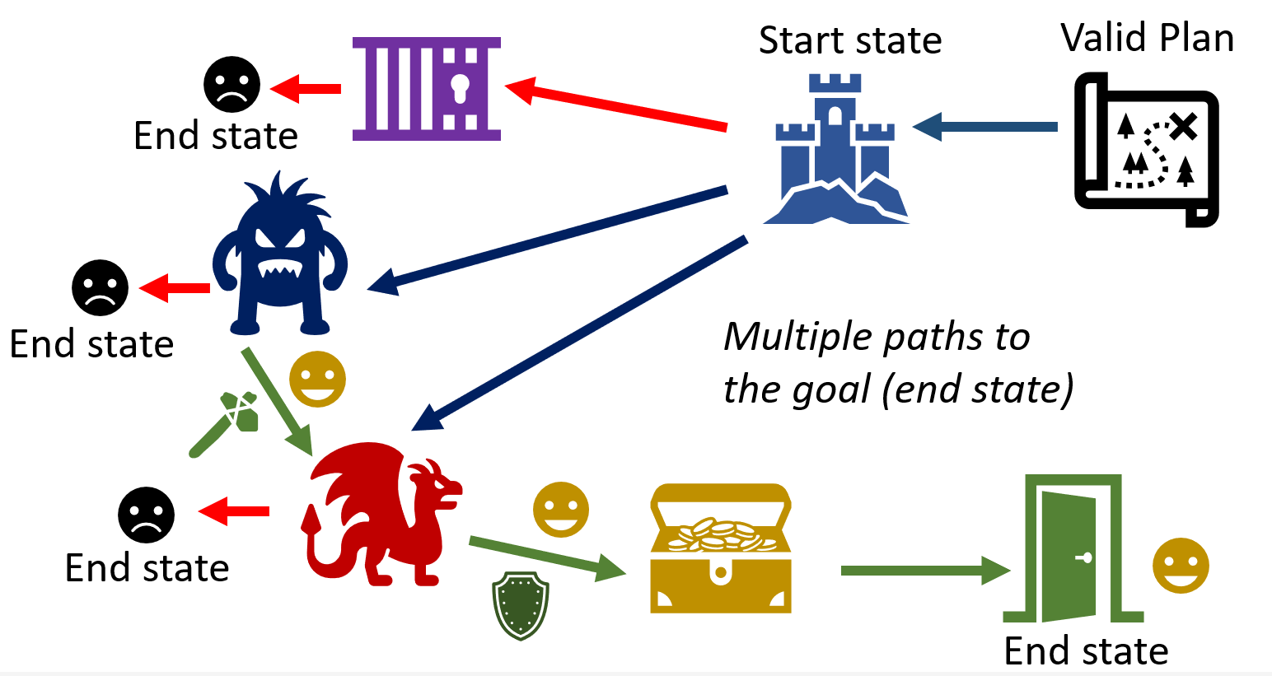
Stay Tuned!

Slide 56

That’s a Wrap…for now!

Slide 57
Overview
Part I - Presentation
Presenter : Rogelio E. Cardona-Rivera:
Module 2 : FROM CLASSICAL TO NARRATIVE PLANNING
Module 3 : MODELING CHARACTERS WITH INTENTION AND CONFLICT
Module 4 : NARRATIVE DOMAINS AND EXPRESSIVE RANGE

Slide 58
Overview
Part II - Presentation
Presenter : Nisha Simon, Contributor : Patrik Haslum
Module 5 : PLANNING FROM A FOCALIZED PERSPECTIVE – INTENTIONALITY
Presenter : Nisha Simon
Module 6 : PLANNING FROM A CHARACTER’S POINT-OF-VIEW (CYOA)
Part III - Demo
Presenters : Nisha Simon, Christian Muise, Rogelio E. Cardona-Rivera

Slide 59
We hope you enjoy today’s story!
Nisha Simon https://nisimon48.github.io/
Christian Muise https://www.haz.ca/
Rogelio E. Cardona-Rivera http://rogel.io/
Arnav Jhala https://arnav.wordpress.ncsu.edu/
Julie Porteous https://porteousjulie.bitbucket.io/
R. Michael Young https://liquidnarrative.eae.utah.edu/rmy/
Patrik Haslum https://comp.anu.edu.au/people/patrik-haslum/

